Slide 1
Marketing Bellabeat smart devices
Chad M. Barrett

Slide 2




Agenda
Review of key questions
Description of data analysis process and procedures
Summary of findings
Recommendations

Slide 3
Key questions
What are some trends in smart device¹ usage?
How could these trends apply to Bellabeat customers?
How could these trends help influence Bellabeat marketing strategy?
¹For this analysis, a smart device is one that gathers biometric data that can be used to identify the user’s activity level.
Notes:
(These don’t have designer IDs since they were based off the default master slides already in the deck.

Slide 4
Data analysis process
Used publicly-available data gathered from smart device users to determine their activity level
Compared activity level of user group with national, publicly-available data
Full records of data analysis process can be found at GitHub
Notes:
(These don’t have designer IDs since they were based off the default master slides already in the deck.

Slide 5
Key finding: Smart device users are generally more active, but not more extremely active
Device users that are least active
Device users that are most active
13% of device users completed no exercise during the data-gathering timeframe
26% of national population is considered sedentary
21% of device users exercise, on average, more than 60 minutes per day
23% of national population exercises, on average, more than 150 minutes per week

Slide 6
Market using images of people living fit: working out, eating right, being active with friends/family.
Recommendation

Slide 7

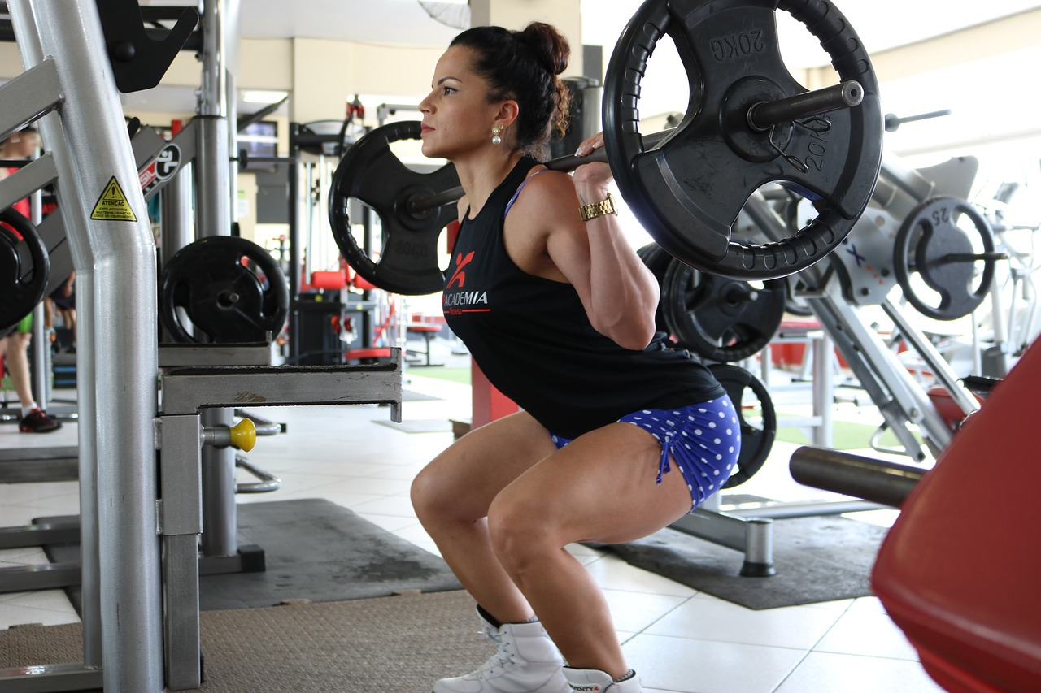
Thank you
Chad M. Barrett
https://chadmbarrett.com

Slide 8
Agenda
With PowerPoint, you can create presentations and share your work with others, wherever they are. Type the text you want here to get started. You can also add images, art, and videos on this template. Save to OneDrive and access your presentations from your computer, tablet, or phone.

Slide 9


Topic one
Subtitle

Slide 10
Chart

Slide 11
Table
 | Category 1 | Category 2 | Category 3 | Category 4
Item 1 | 4.5 | 2.3 | 1.7 | 5
Item 2 | 3.2 | 5.1 | 4.4 | 3
Item 3 | 2.1 | 1.7 | 2.5 | 2.8
Item 4 | 4.5 | 2.2 | 1.7 | 7

Slide 12
The way to get started is to quit talking and begin doing.
Walt Disney

Slide 13





Team
Name
Name
Name
Name
Name
Title
Title
Title
Title
Title

Slide 14
Timeline
Title
To start a presentation, go to the Slide Show tab, and select From Beginning.
Title
To display Presenter view, in Slide Show view, on the control bar at the bottom left select the three dots, and then Show Presenter View.
Title
During your presentation, the speaker notes are visible on your monitor, but aren't visible to the audience.
Title
The Notes pane is a box that appears below each slide. Tap it to add notes.
Title
If you don’t see the Notes pane or it is completely minimized, click Notes on the task bar across the bottom of the PowerPoint window.

Slide 15
Content
Subtitle
Subtitle
Add text, images, art, and videos.
Add transitions, animations, and motion.
Save to OneDrive, to get to your presentations from your computer, tablet, or phone.
Open the Design Ideas pane for instant slide makeovers.
When we have design ideas, we’ll show them to you right there.
Notes:
(These don’t have designer IDs since they were based off the default master slides already in the deck.

Slide 16
Content
Subtitle
Subtitle
Subtitle
Add text, images, art, and videos.
Add transitions, animations, and motion.
Save to OneDrive, to get to your presentations from your computer, tablet, or phone.
Open the Design Ideas pane for instant slide makeovers.
When we have design ideas, we’ll show them to you right there.
This PowerPoint theme uses its own unique set of colors, fonts, and effects to create the overall look and feel of these slides.
PowerPoint has tons of themes to give your presentation just the right personality.

Slide 17


Summary
With PowerPoint, you can create presentations and share your work with others, wherever they are. Type the text you want here to get started. You can also add images, art, and videos on this template. Save to OneDrive and access your presentations from your computer, tablet, or phone.

